Slide 1

Early School Leaving and NEETs across the Danube Region – Towards new regional perspectives
18th December 2018, Vienna

Slide 2
Agenda
DTP in a Nutshell
3rd CfP main elements

Slide 3

What is DTP?
One of the 107 Interreg Programmes 2014-2020
transnational, cross-border, interregional

Slide 4
DTP mission
DTP 2014-2020 finances projects implemented by large transnational consortia aiming at improving the public policies and institutional cooperation in the Danube region.

Slide 5
What DTP is NOT!
DTP is NOT:
The Danube Strategy Programme!
EU Strategy for the Danube Region!
The only financing instrument for EUSDR!
A Programme addressing Danube riparian areas only!
A Programme for big infrastructure!
A research Programme!
A Programme aiming at mere networking!
A Programme for funding initiatives which could be better funded by other instruments

Slide 6




DTP Priority Areas and S.O.s
Innovative and socially responsible Danube Region 1.1: Improve framework conditions for innovation 1.2: Increase competences for business and social innovation
Environment and culture responsible Danube Region 2.1: Strengthen transnational water management and flood risk prevention 2.2: Foster sustainable use of natural and cultural heritage and resources 2.3: Foster the restoration and management of ecological corridors 2.4: Improve preparedness for environmental risk management
Better connected and energy responsible Danube Region
3.1: Support environmentally-friendly and safe transport systems and balanced accessibility of urban and rural areas 3.2: Improve energy security and energy efficiency
Well governed Danube Region 4.1:Improve institutional capacities to tackle major societal challenges 4.2: Support the governance and implementation of the EUSDR

Slide 7
Eligible Costs
1. Staff cost
Real cost OR
Flat rate (up to 20% of the direct cost)
2. Office and admin.
Flat rate (15% of staff cost)
3. Travel & accommodation
4. External expertise & services
5. Equipment
6. Infrastructure & works

Slide 8

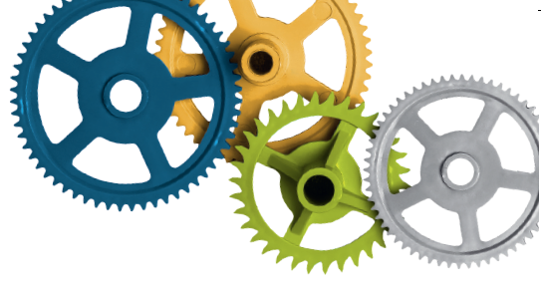

3rd CfP – Main elements
3rd Call for Proposals
To be launched soon!
Two step approach:
1st step: submission of a short Expression of Interest
(and if successful)
2nd step: submission of a complete Application Form
Call budget: up to 60M EUR (ERDF, IPA, ENI)
Max project duration: 30 months

Slide 9
3rd CfP – Main elements
Budget* of the 3rd Call for Proposals in EUR
* All amounts in the table are subject to MC approval.
PA | ERDF | IPA | ENI MD | ENI UA | Total
PA1 | 13,463,630.97 | 795,801.87 | 594,479.00 | 648,471.95 | 15,502,383.79
PA2 | 16,460,009.81 | 974,337.27 | 743,098.00 | 810,590.70 | 18,988,035.78
PA3 | 11,068,880.71 | 671,049.92 | 520,168.50 | 567,413.00 | 12,827,512.13
PA4 | 9,918,396.26 | 858,974.77 | 625,000.00 | 625,000.00 | 12,027,371.03

Slide 10
3rd CfP – Main elements
Information for applicants / official launch
Official launch end of 2018 - beginning of 2019
BUT “Application pack” already available:
Applicants Manual
EoI templates
Guidelines for EoI
http://www.interreg-danube.eu/calls/calls-for-proposals/third-call-for-proposals

Slide 11
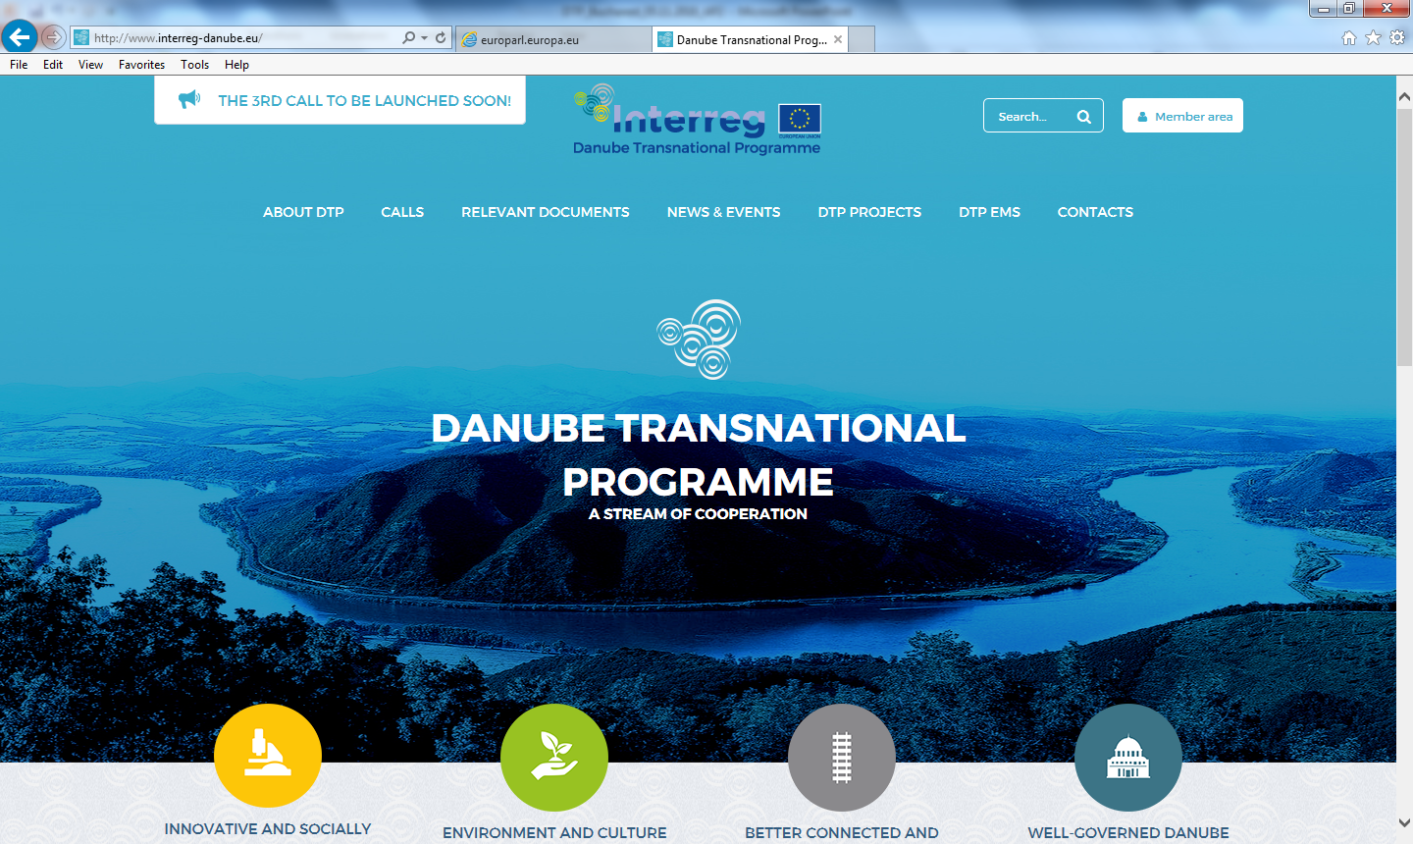
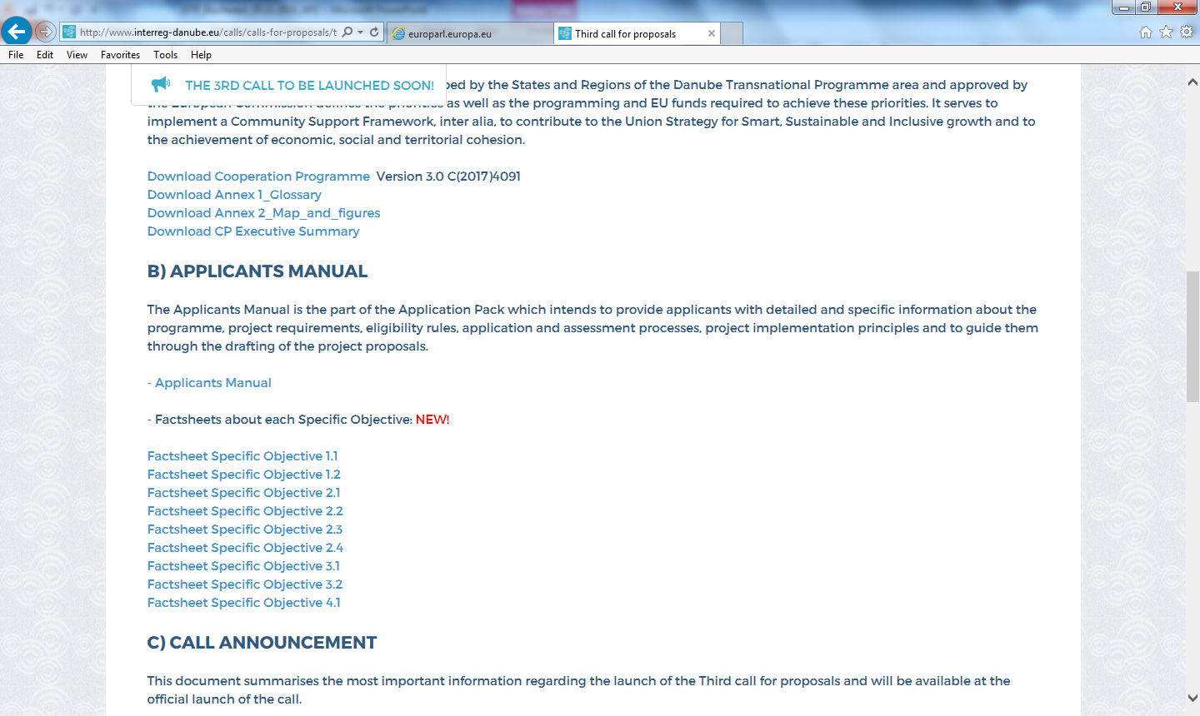
3rd CfP – Main elements

Slide 12






3rd CfP – Main elements
Addressed priorities and specific objectives
Innovative and socially responsible Danube Region
Environment and culture responsible Danube Region
Better connected and energy responsible Danube Region
Well governed Danube Region
SO 4.1 OPEN
SO 2.1
SO 2.2 OPEN
SO 2.3 OPEN
SO 2.4 OPEN
SO 1.1
SO 1.2
SO 3.1
SO 3.2 OPEN
Opening of SO 4.1 is subject to approval of the programme budget reallocation by the EC

Slide 13
3rd CfP – Main elements
SO 4.1: Improve institutional capacities to tackle major societal challenges
*Opening is subject to approval of the programme budget reallocation by the EC.
Strengthen multi-level and transnational governance and institutional capacities and provide viable institutional and legal frameworks for more effective, wider and deeper transnational cooperation across the Danube region in areas with major societal challenges.
If opened No restrictions for the 3rdCall!

Slide 14
3rd CfP – Main elements
SO 4.1: Improve institutional capacities to tackle major societal challenges
Expected Results
Improved capacities of public institutions and stakeholders to tackle major societal challenges in fields such as
Demographic change and migration
Inclusion of vulnerable and marginalized groups, esp. Roma communities
Labour market policies, education systems & policies
Participatory planning processes and involvement of civil society
Urban-rural cooperation and partnership
Cooperation on safety, justice and security

Slide 15
3rd CfP – Main elements
SO 4.1: Improvement of institutional capacities
No restrictions under this S.O. but certain topics highlighted for ensuring strategic impact and avoiding duplications:
Education: Stronger focus on increasing the educational attainment, recognition of skill-level across borders and provision of educational services for vulnerable / marginalised groups
Migration: stronger focus on labour market implication, inclusive approaches regarding specific target groups (e.g. woman, low skilled) and service provision (e.g. health care or housing);
Labour market policies: stronger focus on youth and access to quality employment for specific target groups (e.g. youth, elderly, woman, vulnerable groups).
Active citizenship and sustainable democracy

Slide 16

Project Officer PA4 Johannes Gabriel johannes.gabriel@interreg-danube.eu +36 1 795 5886
3rd CfP – Main elements

Slide 17
3rd CfP – Main elements
What to consider when applying?
Thematic scope clearly in line with one S.O.
Transnational dimension and territorial relevance
Composition of the partnership
Balanced budget / value for money
Realistic and consistent workplan

Slide 18
3rd CfP – Main elements
What to consider when applying under S.O.4.1?
Clear reference to one of the governance bottlenecks defined in the Cooperation Programme or additionally highlighted for the 3rd CfP.
Clear multi-level governance set-up across sectors (public – private – civil) and administrative levels (national – regional – local).
Contact with responsible JS PO(s), also for ensuring clear demarcation from S.O. 1.2 (submission of “concept note” followed up by bilateral consultation)

Slide 19
3rd CfP – Main elements
Thematic seminars
Bucharest (RO), 4th December 2018 Transport
Ecological corridors
Prague (CZ), 14th December 2018 Water management and flood protection
Natural and cultural heritage
Energy
Stuttgart (DE), 19th December 2018 Innovation
Bratislava (SK), 15th January 2019 Governance
National Info Days
(check the DTP website for updates!)

Slide 20

Joint Secretariat
www.interreg-danube.eu

