Slide 1
The impact of digitalisation on labour markets and skill profiles
International Stakeholders Conference on Investing in People and Skills in the Danube Region: The Future of Work – 9 October 2017, Chisinau
Ummuhan Bardak, European Training Foundation (uba@etf.europa.eu)
Notes:
Explain what win/win/win is

Slide 2
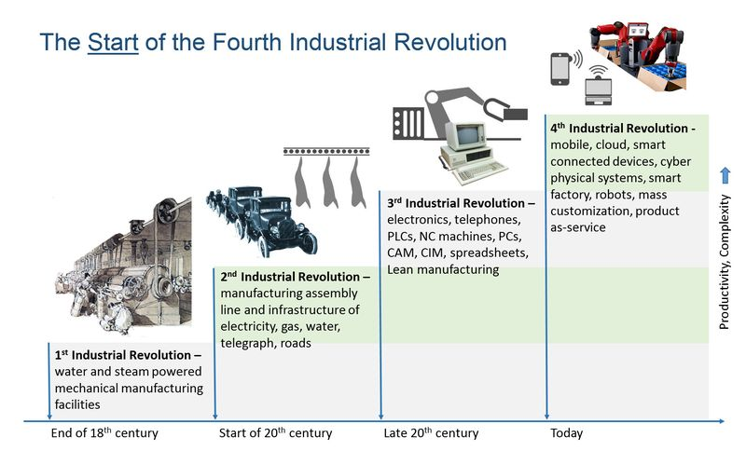

Slide 3
Industry 4.0 and digitalisation
Industry 4.0 differs from others in velocity, scope and systems impact
It evolves at an exponential rather than a linear pace: pervasive diffusion
Some examples of ever increasing pace of technological change:
200 years to reach 1 billion bicycle users
120 years to reach 1 billion car users
8.5 years to reach 1 billion Facebook users (38y for radio to get 50 million listeners)
5.5 years to reach 1 billion Uber rides
87 days to reach 1 billion Adele views on YouTube

Slide 4
The developments we are witnessing
Mobile internet and cloud computing: agility, security, reliability, elasticity
Processing power, Big Data: volume, velocity, veracity, variety, variability
Internet of Things (IoT): electronics, sensors, software, network connectivity
Internet of Services (IoS): using internet for new ways of value creation in services
Advanced manufacturing and 3D printing: materials are formed under computer control to create 3-dimensional objects
Nanotechnology, biotechnology, materials science
Autonomous vehicles, Robotics: new market for service robots
Energy storage, quantum computing
Artificial Intelligence (AI): convergence of physical, digital and biological?

Slide 5
Digitalisation also enhances globalisation
Deeper integration of all production factors
More fragmented industrial production
Increased integration into Global Value Chains (GVC): offshoring
Growth of international trade, penetration of Chinese goods in global economy
Process of de-industrialisation: employment decrease in manufacturing, the rise of service economy
Vastly reduced transaction costs of production, communication and coordination in global scale through new technologies

Slide 6
Signs for changing world of work: Work 4.0
Increased automation in manufacturing: complement and/or substitute labour
Transformations in industrial and occupational structures
Changing nature of work: non-standard, flexible contracts, freelancers, part-timers, teleworking, independent workers, on-call/ on-demand work
Sharing economy, collaborative economy, on-demand economy or ‘gig’ economy
Uberisation: work on-demand/ just-in-time labour: shift from jobs to tasks/ services, shift from employees to independent contractors
Crowd working, crowd-employment, crowd sourcing: a client employer posts micro-tasks on internet platform and selects from a virtual pool of workers

Slide 7
Stylised facts on the skills impact of technological change
“Skills-biased”: higher demand for educated/ skilled workers, prevalence of computer-skill complementarities
“Routine-biased”: routine tasks are increasingly automated, both manual and cognitive
“Job polarisation” as a result: hollowing-out of the medium-skilled jobs
“Capital-biased”: decline in the labour share of income
Changed task/skill composition of many occupations, with higher need for digital skills and the skills linked to intuition/ human judgment (non-routine ‘cognitive’ skills)
Displaced workers in a wide range of jobs, but equally creates new tasks, occupations and industries – Overall impact on employment is ambiguous

Slide 8
“Creative destruction of jobs” in labour markets?
Examples of jobs most likely to disappear:
Crafts and clerical occupations (secretaries, desk officers)
Accountants and account assistants
Auto-mechanics, machine operators
Insurance and credit analysts
Radio operators/ photo processors
Many types of repairers (e.g. watch)
Bank staff and legal assistance
Risk of automation in next decades: 47% of jobs in the USA, 48% in Switzerland, 42% in Germany, 35% in UK, Denmark, 54% in the EU
Examples of new and emerging occupations
Big data specialists, database managers
Cloud and distributed computing, statistical analysis and data mining
Social media managers, marketing campaigners
Cognitive computing engineers, virtualisation
IoT architects and block chain developers
Biochemical engineers, bioinformatics scientists, biostatisticians
Nanosystem engineers, solar energy system engineers, industrial ecologists

Slide 9
Changing composition of sectors: labour reallocation?
EMPLOYMENT DECLINE↓ IN:
Most of manufacturing and production
Office and administrative support
Construction and extraction, chemicals
Transportation, sales and services
Art, design, entertainment, sports and media
Legal/ paralegal
Installation and maintenance
Agriculture
EMPLOYMENT GROWTH↑ IN:
Business and financial operations
Management & healthcare
Accommodation & real estate
Computer and mathematical
Architecture and engineering
Sales and related
Personal care services
Education and training

Slide 10
Jobs in ICT versus non-technology sectors
2/3 of changes occurred in the occupations within sectors (task composition), while 1/3 of changes linked to labour reallocation from industry to services
Employment in ICT sector is small as a share of total employment: ~5% of total employment max. in OECD countries (~15 million workers)
For each high-tech job created, some 5 additional service jobs are created in local economies
Job growth in non-technology sectors is still significant: government services, health care, personal care, accommodation, food, retails (non-tradable sectors)
Job growth in tradable sectors (engineering, finance and banking, computer design) is lower, but they experience very high productivity gains
LM institutions: Stronger EPL amplifies the effect of ICT, while stronger unions reduce the effect of ICT on bottom polarisation in OECD countries

Slide 11
Pros and Cons of Digitalisation in Labour Markets
OPPORTUNITIES:
Enhanced way of matching supply and demand of labour using online technologies
Reduced transaction costs and market frictions by facilitating outsourcing to individuals
Reduced barriers for the vulnerable groups to enter into work life easily (inclusion)
New and atypical job opportunities for people preferring flexible/ innovative working schedules
Easy access to abundant learning opportunities, free of psychical/financial barriers e.g. online/ distant learning
Tremendous increase in the volume of info/ data sources on work life and monitoring work activity
COMMON RISKS:
Widening wealth/ wage inequalities – growing digital divide, a ‘digital underclass’?
Overload of information, loss of privacy, risk of data theft, security threats
Erosion of traditional employer-employee relationship and social security benefits
“Humans-as-a-service”, labour commodification, casualization, devaluation and disguising of work
Blurred lines between private and working life, mostly unilateral flexibility (on workers), no free schedules
Enhanced risks by lack of clarity on employment status, regulation loopholes, ‘dependent self-employment’

Slide 12
What are digital skills and competences (DSC)?
Basic DSC
The use of basic operating system functions, office productivity tools, and the Internet. This is minimum level of basic digital skills
Job-specific DSC
Ability to use digital tools introduced by digital transformation and used to perform specific tasks e.g. software of statistics, architecture, engineering
DSC for digital technology professionals
Skills to create new products and services e.g. programmers, cyber security experts, user interface design, software dev.
EU Digital competences framework
1. Information and data literacy in digital world
2. Communication and collaboration online
3. Digital content creation in ready software(s)
4. Safety in digital devices, content, personal data and privacy
5. Problem solving in digital environment
Today, 90% of jobs require some kind of digital skills, but half of the EU workforce has no or low digital skills
The EU estimates a shortage of 825,000 ICT professionals by 2020 (so-called digital skills gap)

Slide 13
Required skills and resilience for a world of change
COMPETENCES
Complex problem solving
Critical thinking, analytical skills
Creativity, cognitive flexibility
Emotional intelligence
Judgment and decision-making
Communication, collaboration
MINDSET & TALENT
Curiosity
Self-initiative
Persistence
Empathy, social perceptiveness
Adaptability, service orientation
DOMAIN KNOWLEDGE
Area of specialisation, expertise
CORE LITERACIES
Reading and writing ICT Fluency
Numeracy (Foreign) Language skills
Scientific literacy Cultural& civic awareness

Slide 14
Digitalisation in developing and transition countries
Digitalisation affects all without exception, with different paces of technology adoption and impact. They are more ‘technology-absorbers’ than ‘technology-drivers’
Technology absorption is quicker in countries with higher number of skilled workers: today, 45% of total employment worldwide is low-skilled jobs, 37% medium-skilled jobs and 18% high-skilled
Technology diffusion rates affect rate of automation: the share high-skilled jobs varies from 10% in sub-Saharan Africa to 40% in developed economies
Offshored jobs slowdown technology adoption, leading to slower ‘job polarisation’ e.g. hollowing-out of the medium-skilled jobs is not the case in Central Europe
For some others, there are signs for “premature de-industrialisation” or even skipping the phase of industrialisation (combination of automation and globalisation)
By 2020 a shortage of 40 million graduate workers is estimated globally, but developing countries will experience a shortage of 45 million workers with upper secondary/ VET education

Slide 15
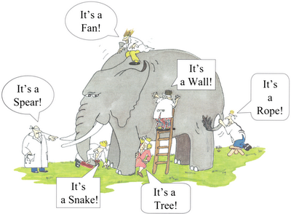
Final word: Digitalisation is the elephant…
The future of work is all about skills!
“There’s never been abetter time to be a worker with special skills or the right education, because these people can use technology to create and capture value. However, there’s never been a worse time to be a worker with only ‘ordinary’ skills and abilities to offer, because computers, robots and other digital technologies are acquiring these skills and abilities at an extraordinary rate.” (Brynjolfsson and McAfee 2014, The Second Machine Age)
REFITTING EDUCATION IS KEY!

