Slide 1

Strategy Meeting of Working Groups related to Education
EUSDR/ PA9/ Working Groups 1,3,4,5
Vienna, 17 -18 October 2012

Slide 2
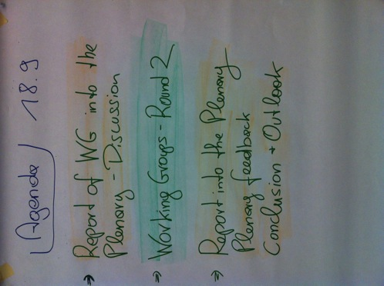
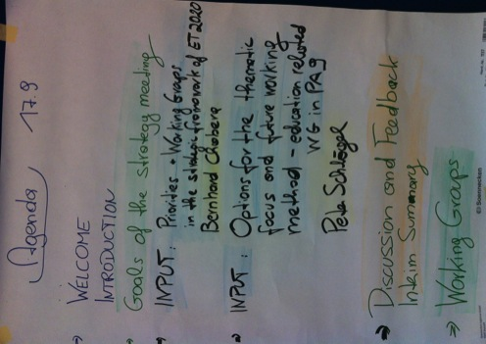
Agenda

Slide 3
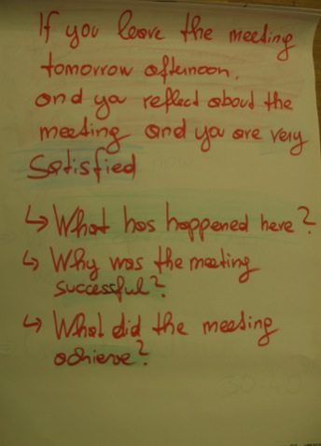
Expectations for the Meeting

Slide 4
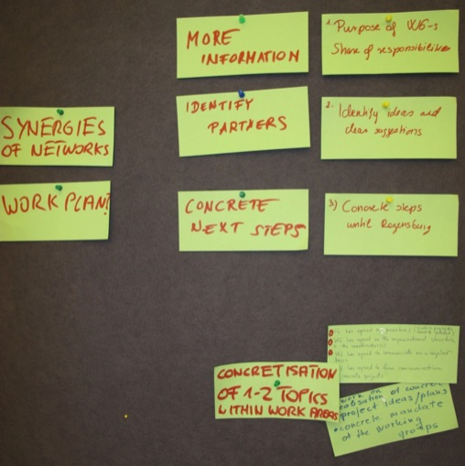
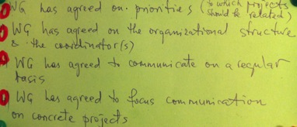
Expectations for the Meeting

Slide 5
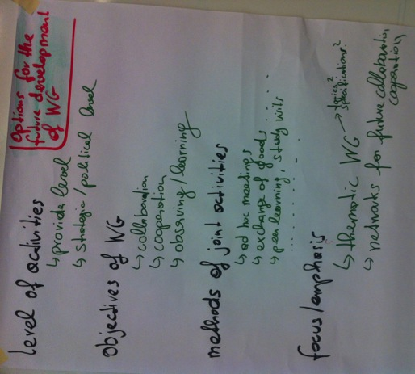
Options for the future development of the Working Groups Key issues and questions raised by Peter Schlögl

Slide 6
After the presentations of Bernhard Chabera and Peter Schlögl: Discussion and Feedback
Plenary
What is clearer now/ still unclear?
What should we work on now?
Which options can we realize?
General Feedback (30´- 40´)
Working Groups: Round 1
Who has here energy to work on what?
Division of the WG/ specification?
Commitment/ interest?
Level of interest?
Objectives?
Methods
Focus/ emphasis

Slide 7
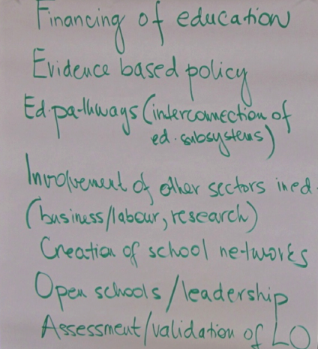
Results of Working Group Round 1: WG 1: Enhance performance of Education Sytems through closer cooperation

Slide 8
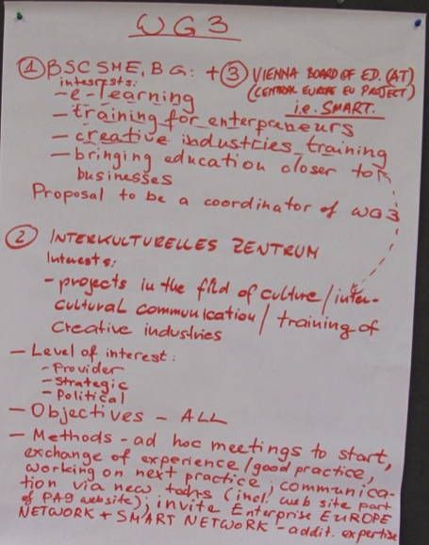
Results of Working Group Round 1: WG 3: Support creativity and entrepreneurship

Slide 9
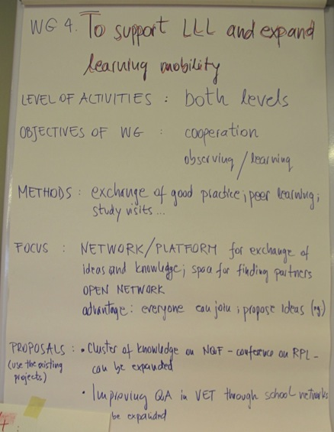
Results of Working Group Round 1: WG 4: LLL and mobility

Slide 10
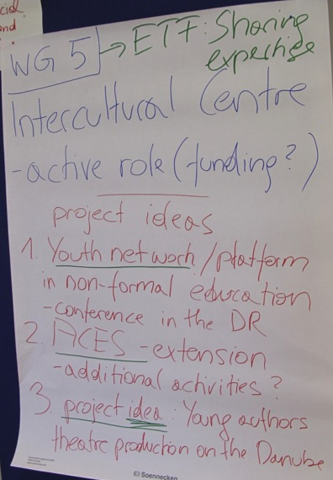
Results of Working Group Round 1: WG 5: Equity, Social Cohesion and Active Citizenship

Slide 11
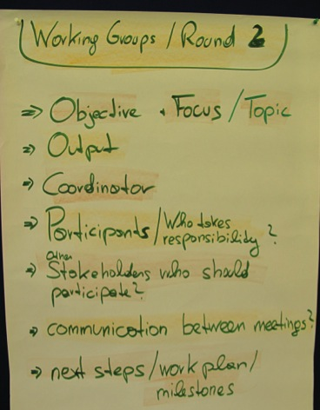
Working Groups Round 2

Slide 12
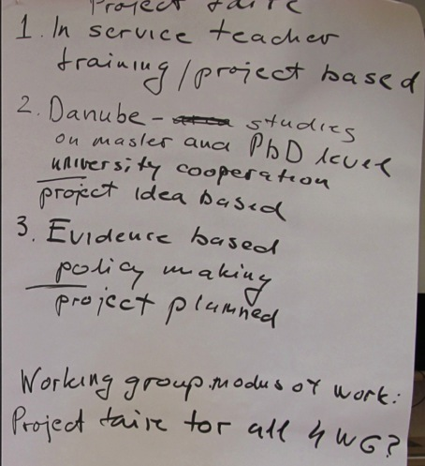

Results of Working Group Round 2: WG 1: Enhance performance of Education Sytems through closer cooperation

Slide 13
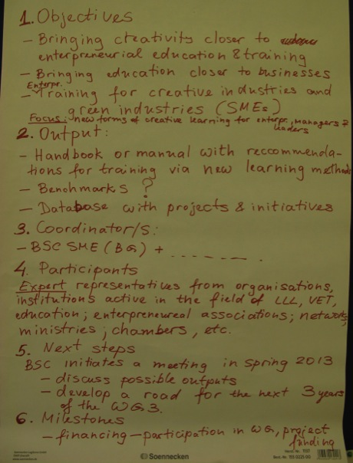
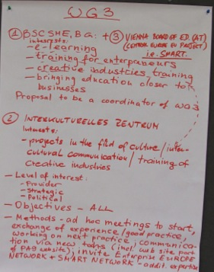
Results of Working Group Round 2: WG 3: Support creativity and entrepreneurship

Slide 14
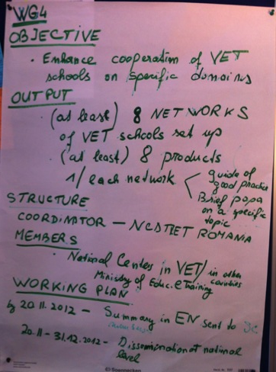

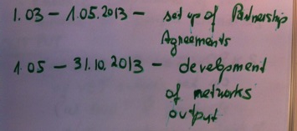
Results of Working Group Round 2: WG 4: LLL and mobility

Slide 15
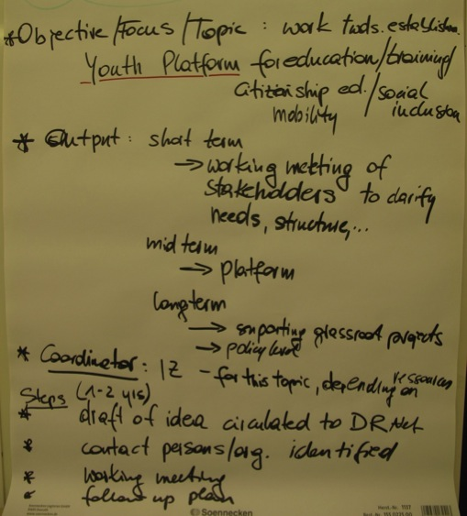

Results of Working Group Round 2: WG 5: Equity, Social Cohesion and Active Citizenship

