Slide 1
When economic growth is not enough
Dessy Gavrilova,
Founder and Chair, The Red House Center for Culture and Debate, Sofia

Slide 2
GDP Real Growth in the Danube Region
(Source: wiiw Database incorporating national and Eurostat statistics)

Slide 3
Youth unemployment rate
(Source: National and Eurostat statistics based on LFS)

Slide 4
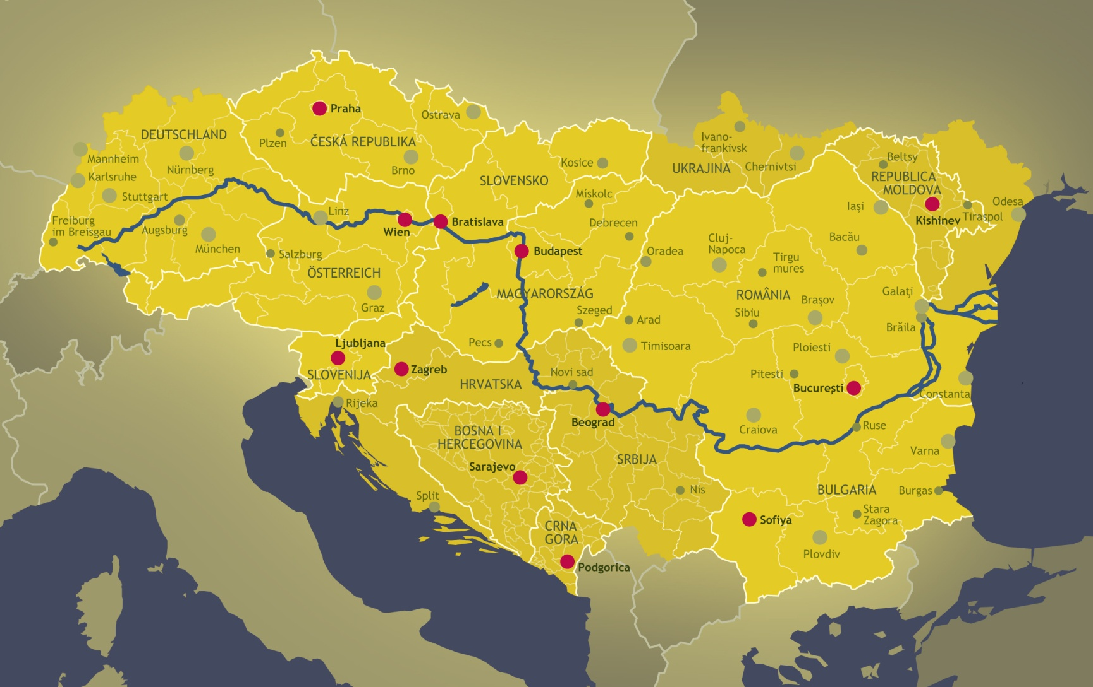
The flow of the Danube

Slide 5
Eurobarometer: How happy are people to live in they countries

Slide 6
Eurobarometer: the life of today's children will be more difficult than ours

Slide 7
Balkans: If Yugoslavia survived, would you live better now? (Data: European Fund for the Balkans)

Slide 8
In comparison with your life today, what was the life of your parents like in your opinion?
(Data: European Fund for the Balkans)

Slide 9
Life Satisfaction in the Danube region
(Source: World Happiness Report)

Slide 10
Hierarchy of factors affecting psychological well-being
1 Diseases
2 Cultural participation
3 Income
4 Age
5 Education
6 Gender
7 Job
8 Geography

Slide 11
Classical Music concerts attendance and wellbeing (Source: The Italian culture and well-being study, IULM/Bracco)

Slide 12
Theatre attendance and wellbeing (Source: The Italian culture and well-being study, IULM/Bracco)

Slide 13
THANK YOU FOR YOUR ATTENTION!

